Slide 1
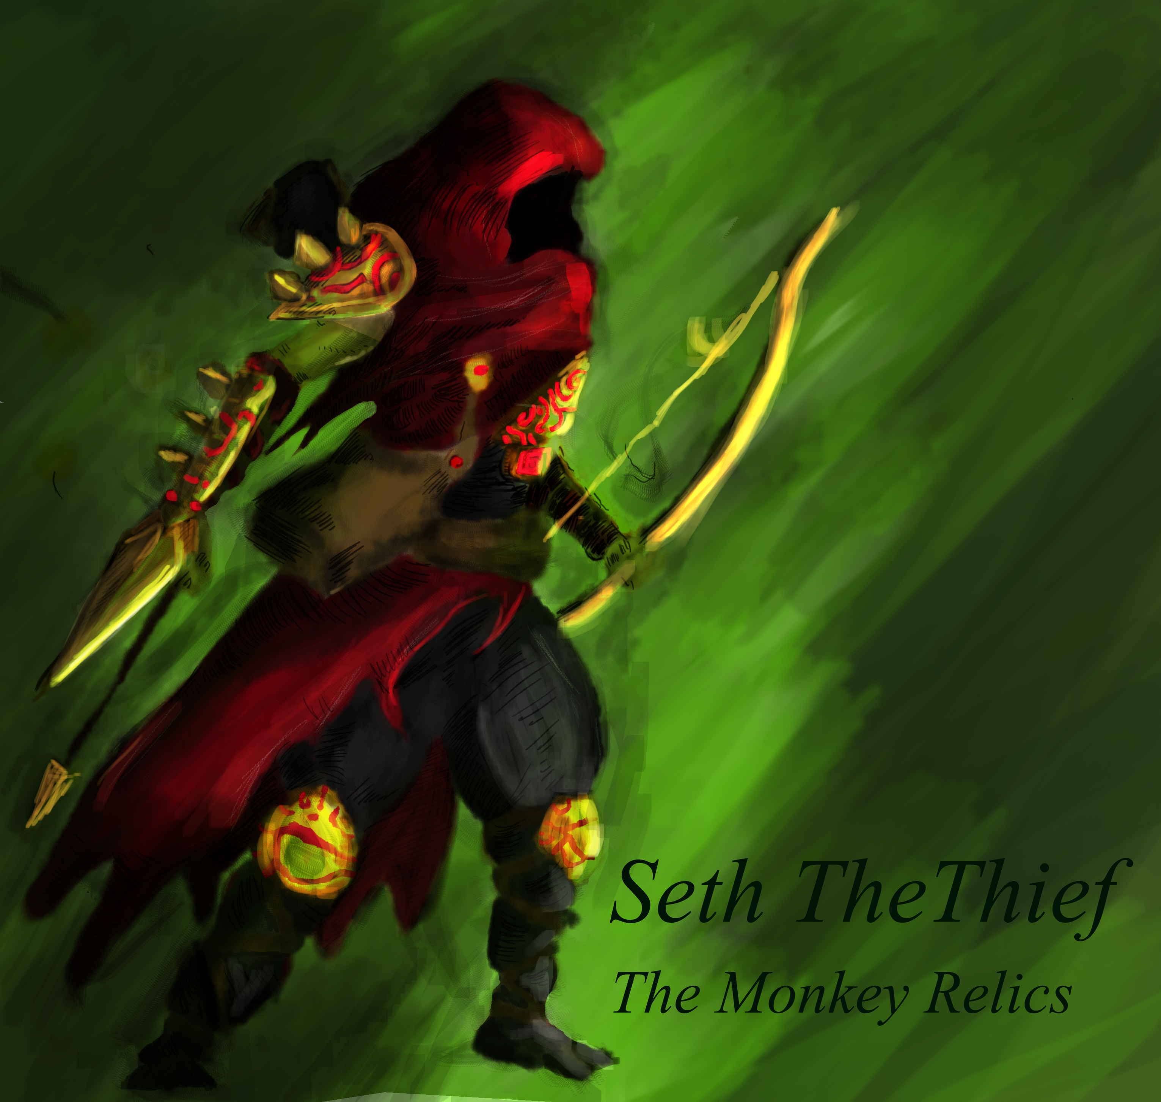

Slide 2
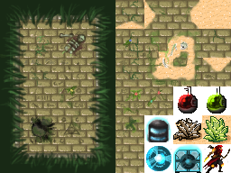

Me.
Keimpe Snip

Slide 3
Tiles.

Slide 4
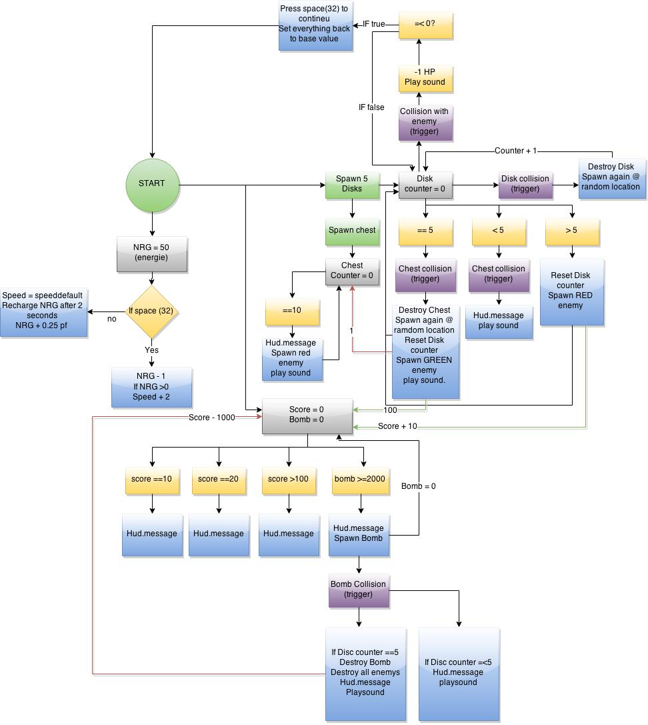
Flowchart.

Slide 5
The Game.
Seth the Thief – Monkey Relics

Slide 6

Code.

